Slide 1

Montgomery County Demographic Trends – Presentation to the Montgomery County Council

Slide 2
Today’s Topics
Introduction to key demographic trends, countywide and by district:
  Population growth
  Racial and ethnic change
  Large immigrant community
  Changing households and ages
  Income, education, and workforce

Slide 3
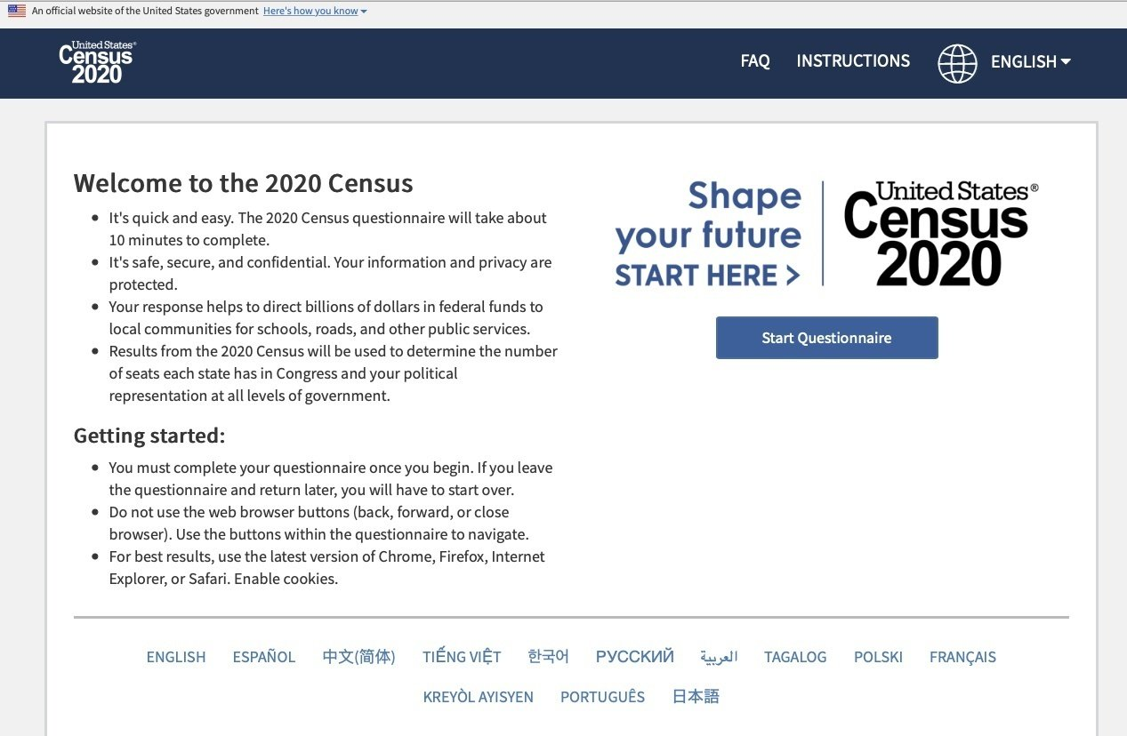
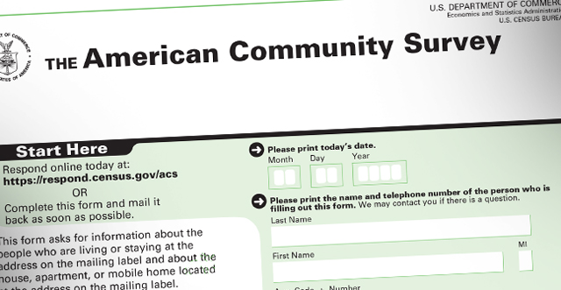
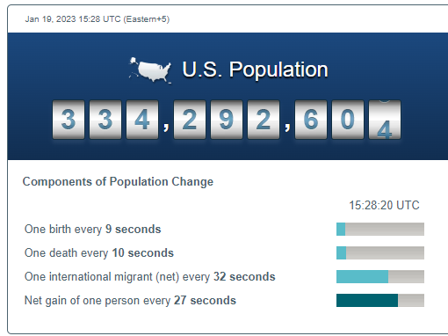
Where do we get demographic data?
American Community Survey (ACS)
Annually
3.5 million household sample
Detailed data on race, income, education, occupation, commuting, housing, etc.
Data available in 1-year and 5-year tabulations
Population Estimates Program
Annually
Population and housing estimates for country, states, counties, cities, towns
Age and race characteristics
Decennial Census
Every 10 years
Everyone counts
Main purpose is for congressional representation

Slide 4
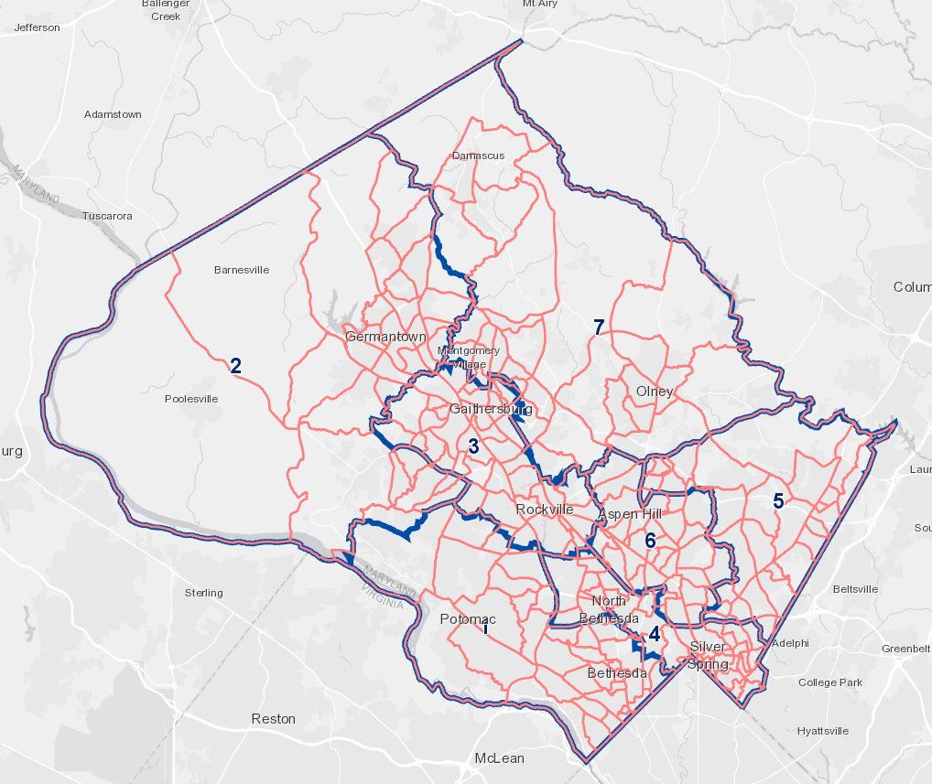
Geographies

Slide 5
A large, slow growing jurisdiction

Slide 6
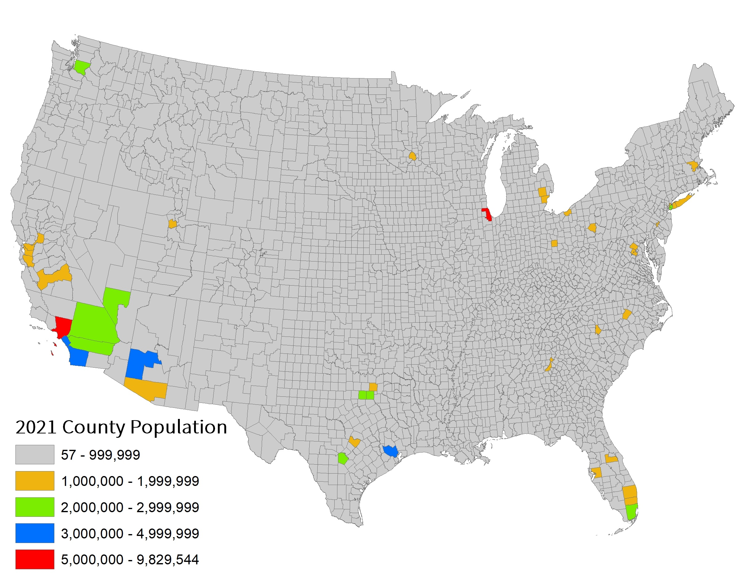
Montgomery County is the 44th largest county in the United States.
2021 pop = 1.05M
Fairfax is largest county in
DC Metro with >1.1M
Montgomery County’s population = 17% of the Maryland state population
Source: 2021 Population Estimates Program, U.S. Census Bureau

Slide 7
Population growth rates reflect a mature, built out county.
Source: 1950-2020 Census and 2021 Population Estimates, U.S. Census Bureau

Slide 8
New Council districts have approximately 44,000 fewer people than old districts
*Population living in households
Source: 2010 Decennial Census
*Population living in households
Source: 2016-2020 American Community Survey, 5-year estimate.

Slide 9
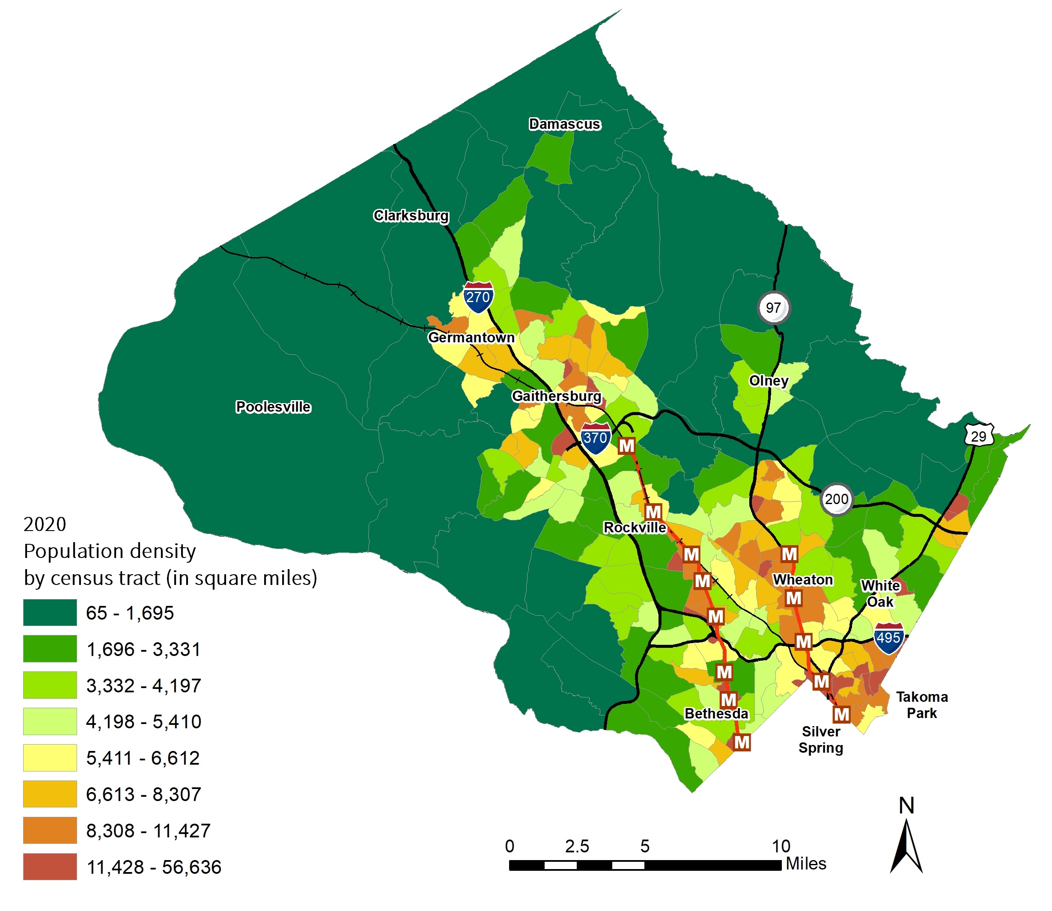
Population concentrated around core centers and corridors
Source: 2020 Decennial Census, U.S. Census Bureau

Slide 10
Population density by district and countywide
District Area (Square Miles):
62.7 | 187.0 | 33.6 | 20.3 | 45.7 | 24.5 | 133.1 | 506.9
Source: 2016-2020 American Community Survey, 5-year estimate

Slide 11
Racial and ethnic change

Slide 12
Population by race/ethnicity (1960-2020)
Source: 1990-2020 Decennial Census, U.S. Census Bureau

Slide 13
3 of 5 districts and the county overall were majority people of color in 2010
Source: 2006-2010 and 2010 American Community Survey, U.S Census Bureau

Slide 14
6 of 7 districts and the county overall are majority people of color today
Source: 2016-2020 American Community Survey, 5-year estimate, US Census Bureau

Slide 15
Characteristics of the foreign-born population

Slide 16
Percentage foreign born
33% of total population
346,586 residents
Source: 1980-2000 Decennial Census and 2010 and 2021 American Community Survey, 1-year estimate, U.S. Census Bureau

Slide 17
Top regions and countries of origin
Country of Origin
El Salvador | 10.2%
China, excluding Hong Kong and Taiwan | 7.3%
India | 7.1%
Ethiopia | 5.3%
Philippines | 3.0%
Korea | 2.7%
Peru | 2.7%
Guatemala | 2.7%
Iran | 2.5%
Honduras | 2.4%
Source: 2021 American Community Survey, 1-year estimate, U.S. Census Bureau

Slide 18
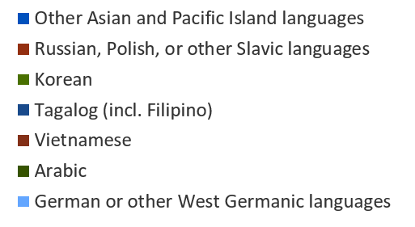
Top languages spoken at home
Each < 3.0%
Source: 2021 American Community Survey, 1-year estimate, U.S. Census Bureau

Slide 19
English language usage and proficiency by district and countywide
Source: 2016-2020 American Community Survey, 5-year estimate, US Census Bureau

Slide 20
Educational attainment
Source: 2021 American Community Survey, 1-year estimate, U.S. Census Bureau

Slide 21
Household composition and age distribution

Slide 22
Household composition (1960-2021)
Source: 1960-2020 Decennial Census, 2021 American Community Survey, 1-year estimates, U.S. Census Bureau

Slide 23
Household composition by district and countywide
Average HH Size
2.61
3.02
2.62
2.40
2.88
3.08
3.02
2.79
Source: 2016-2020 American Community Survey, 5-year estimate, US Census Bureau

Slide 24
Housing tenure by district and countywide
Source: 2016-2020 American Community Survey, 5-year estimate, US Census Bureau

Slide 25
Population projection by age
Percentage of Population by Age Group
Source: 2021 Population Estimates, U.S. Census Bureau; Maryland Department of Planning Age Forecast (2020).

Slide 26
Age distribution by race or ethnicity
Source: 2021 Population Estimates Program, U.S. Census Bureau

Slide 27
Age distribution by district and countywide
Source: 2016-2020 American Community Survey, 5-year estimate, US Census Bureau

Slide 28
Income, education, and workforce

Slide 29
Median income regional comparison
Source: 2021 American Community Survey, 1-year estimate, U.S. Census Bureau

Slide 30
Income distribution by race
1 in 5 households has an income <$50,000
 | White | Asian | Hispanic | Black | County
Households <$50k | 29,278 | 10,934 | 16,826 | 21,929 | 78,967
Households $150k+ | 88,715 | 23,886 | 13,096 | 16,022 | 141,719
Total Households | 190,250 | 57,205 | 58,438 | 74,217 | 380,110
Source: 2021 American Community Survey, 1-year estimate, U.S. Census Bureau

Slide 31
Income distribution by district and countywide
Average Household Income:
$265,145 | $144,595 | $130,542 | $142,032 | $116,232 | $118,878 | $142,860 | $152,779
Source: 2016-2020 American Community Survey, 5-year estimate, US Census Bureau

Slide 32
Percentage of renter households spending >35% of income on housing costs
Source: 2016-2020 American Community Survey, 5-year estimate, US Census Bureau

Slide 33
Educational attainment by race
Source: 2021 American Community Survey, 1-year estimate, U.S. Census Bureau

Slide 34
Educational attainment by district and countywide
Source: 2016-2020 American Community Survey, 5-year estimate, US Census Bureau

Slide 35
Worker type by district and countywide
Source: 2016-2020 American Community Survey, 5-year estimate, US Census Bureau; Civilian only

Slide 36
Place of work by district and countywide
Source: 2016-2020 American Community Survey, 5-year estimate, US Census Bureau

Slide 37
Percentage of people working from home by district and countywide
2021 American Community Survey
37%
Source: 2012-2016 American Community Survey, 5-year estimate, 2016-2020 American Community Survey, 5-year estimate, US Census Bureau

Slide 38
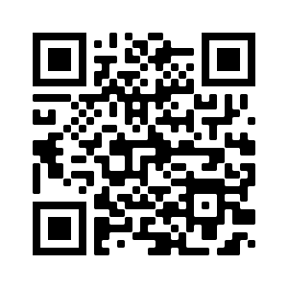

Research resources
Trends in Racial and Ethnic Diversity in Montgomery County (1990-2020)
Council District Demographic Profiles (2020)
Neighborhood Change in the Washington Metropolitan Area
Montgomery County Economic Indicators Briefing, Q3 2022
Montgomery Planning: www.montgomeryplanning.org
Montgomery Planning Research: www.mcfacts.org
THANK YOU!
Carrie McCarthy, Division Chief
Montgomery Planning Research and Strategic Projects
Caroline.mccarthy@montgomeryplanning.org

